Slide 1
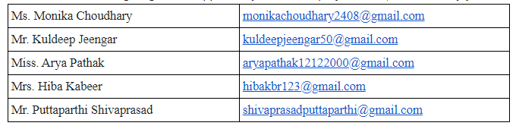
P-191 Customer Churn

Slide 2
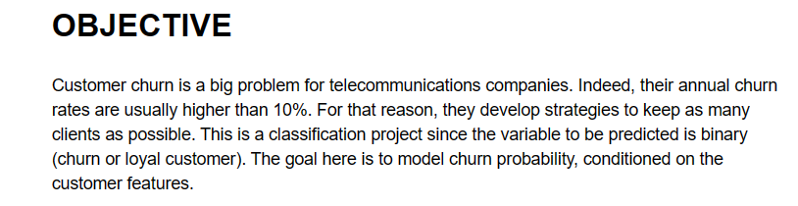
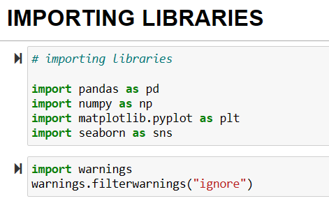
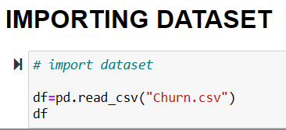

Slide 3
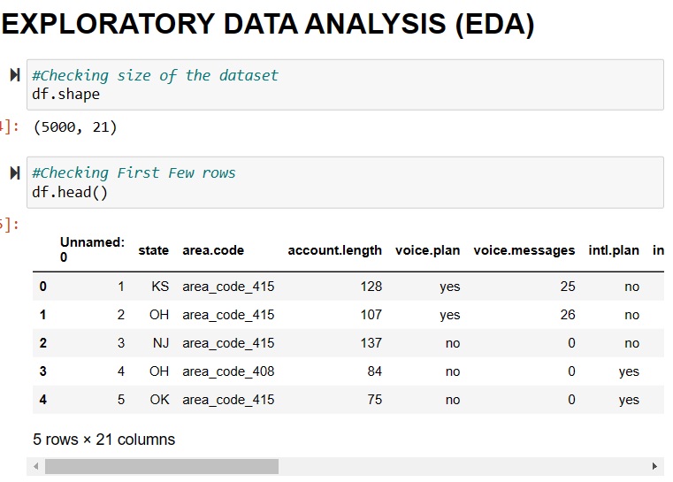
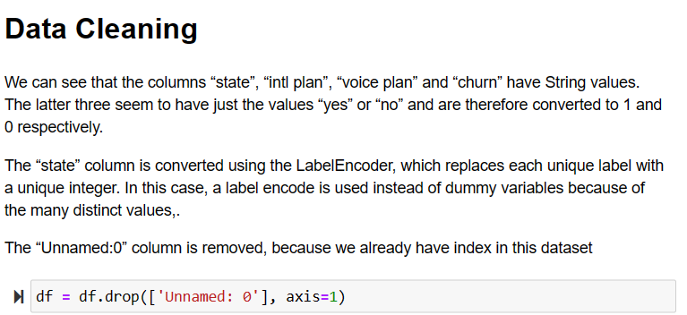
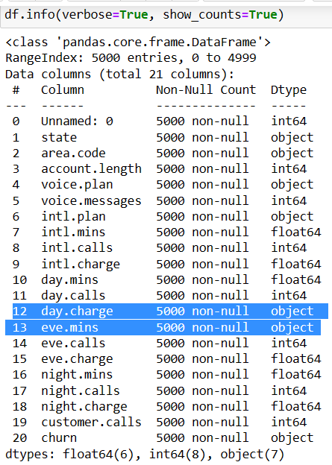

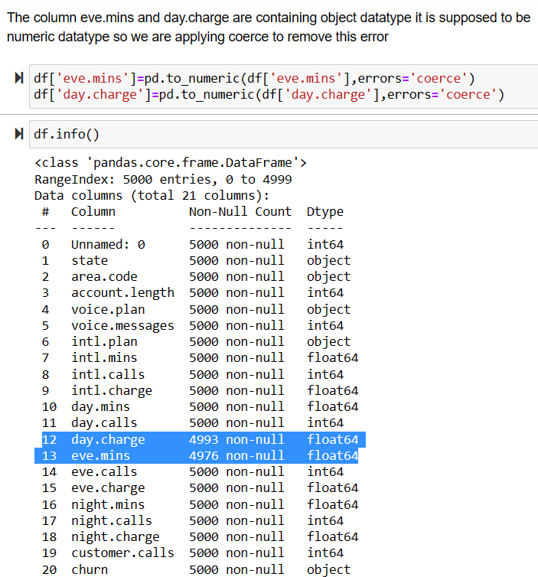
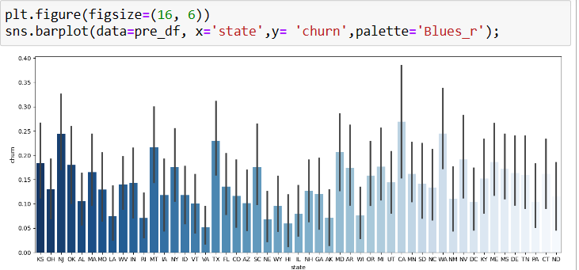

Slide 4
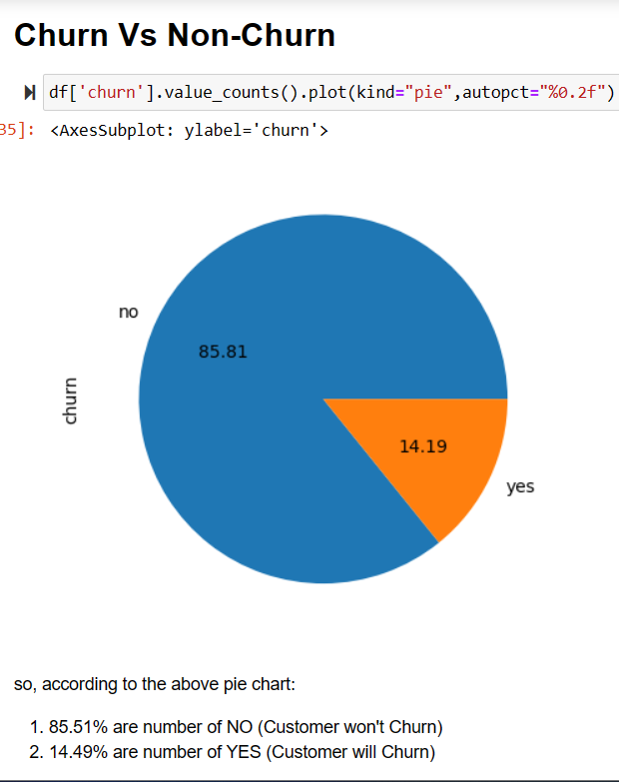
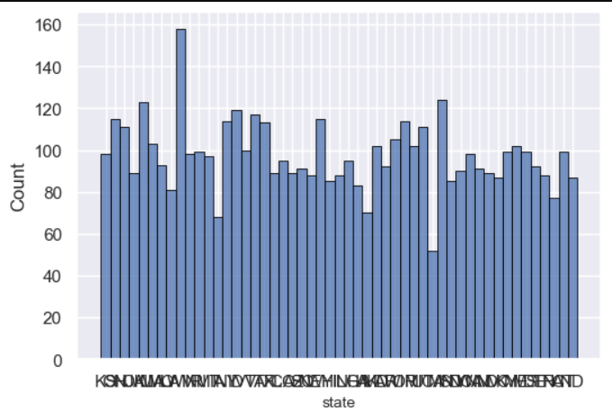
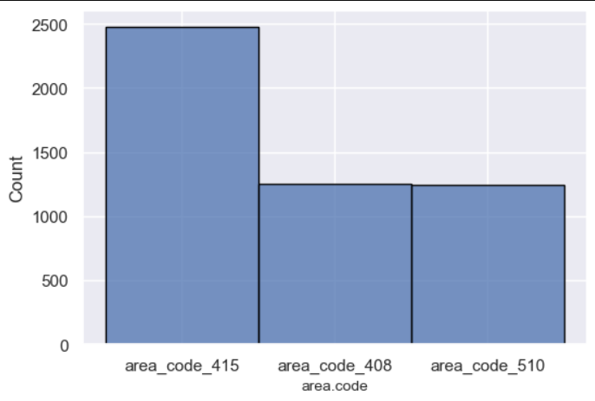
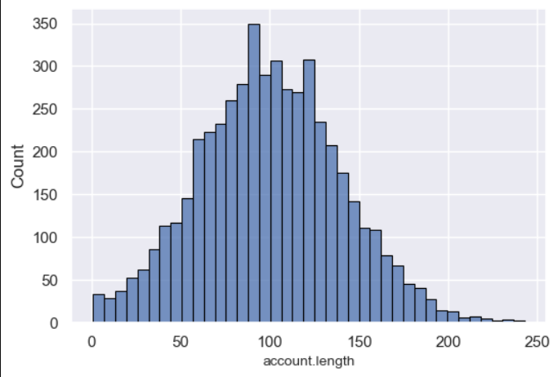
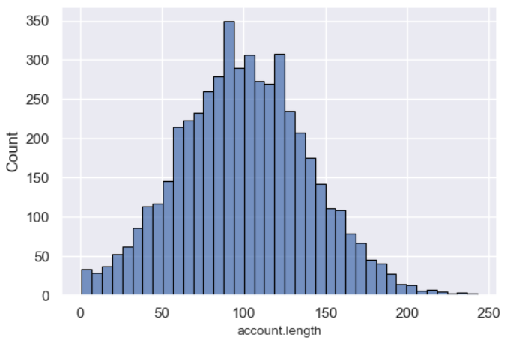
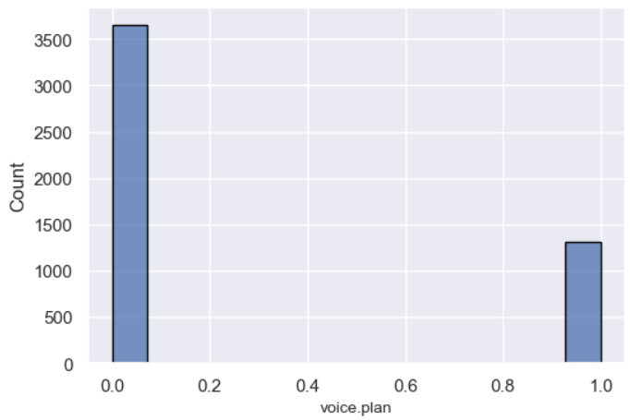
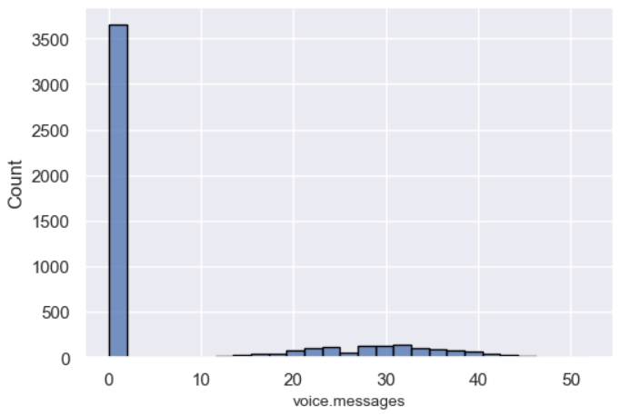
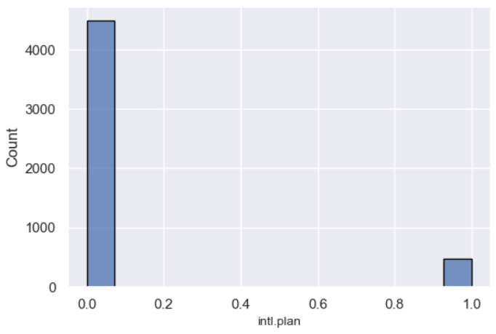
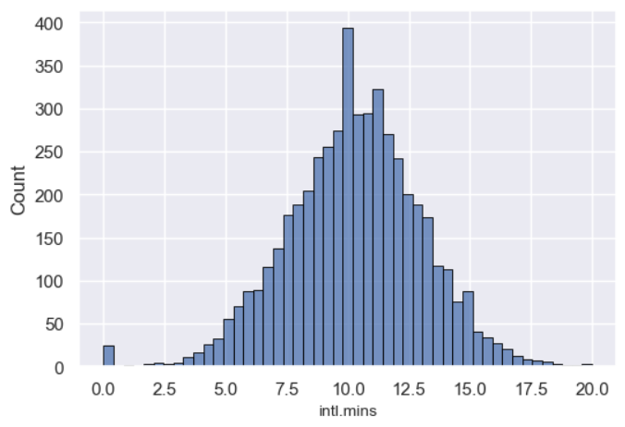
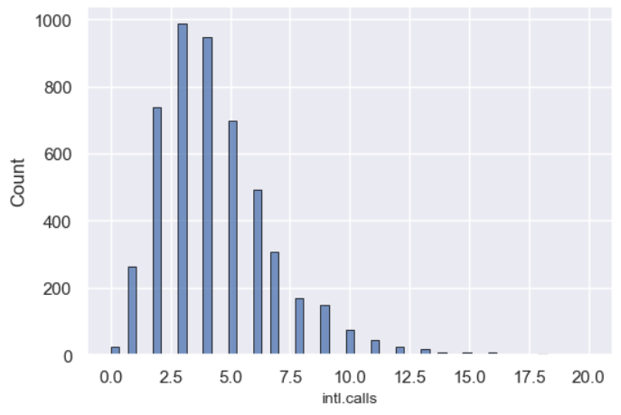

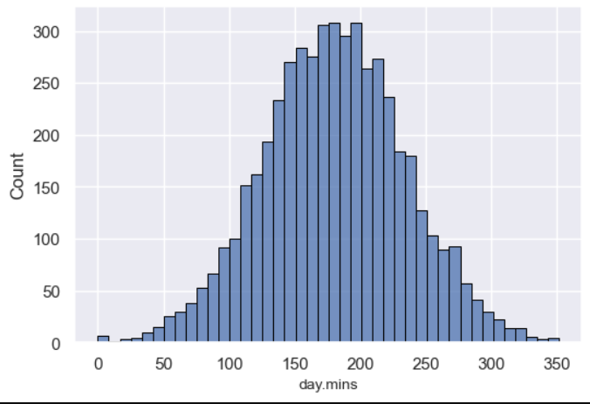
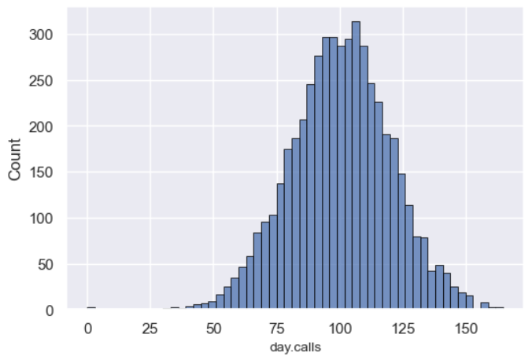
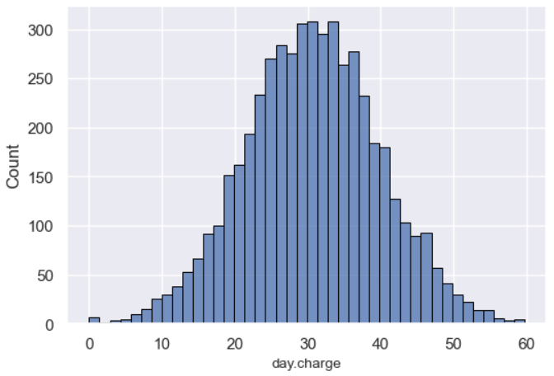
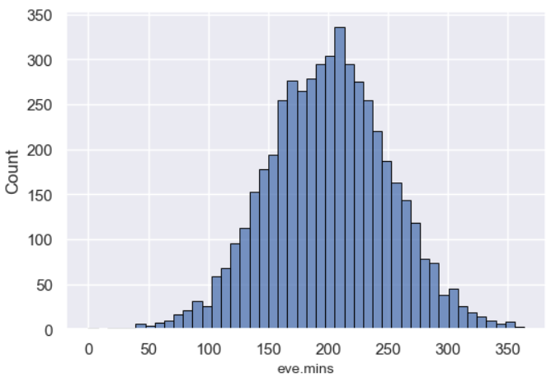
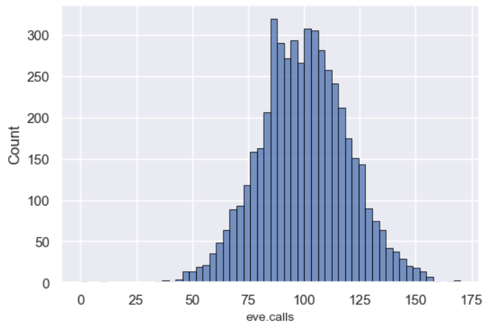
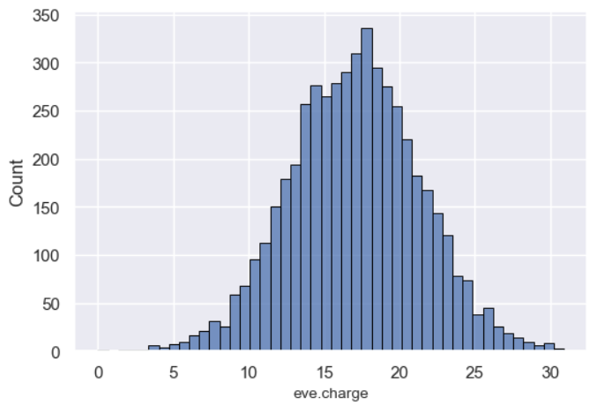
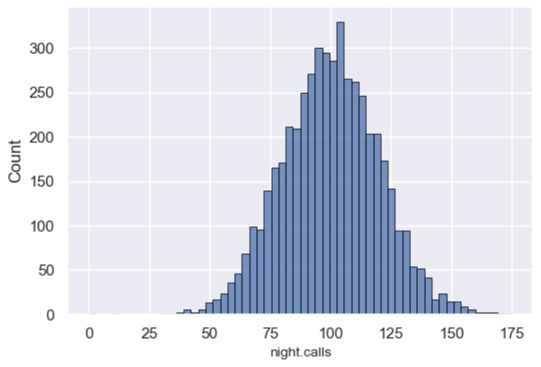
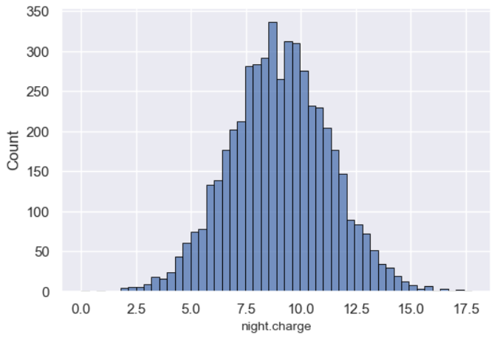
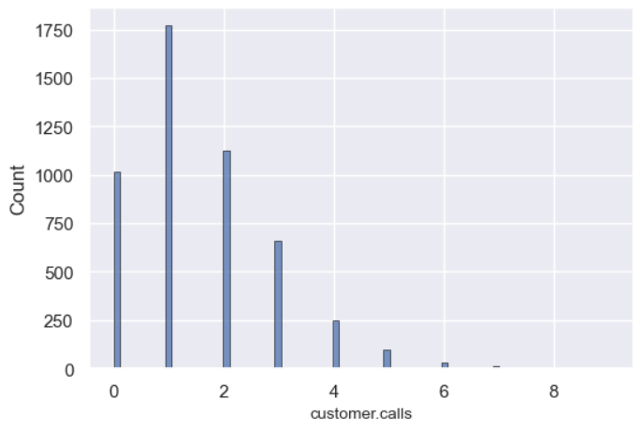
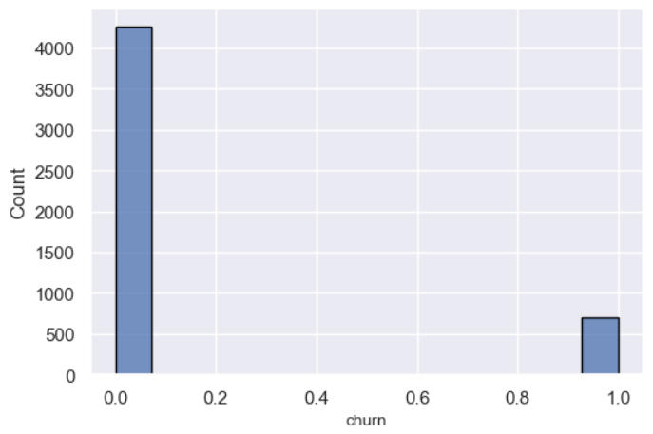
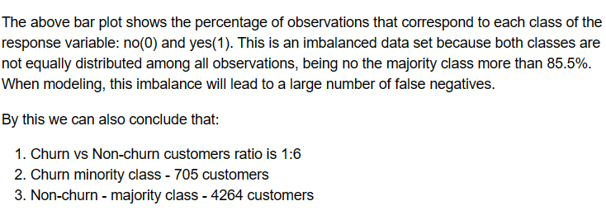
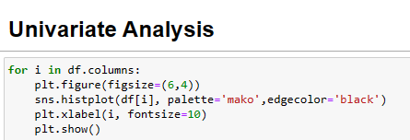

Slide 5
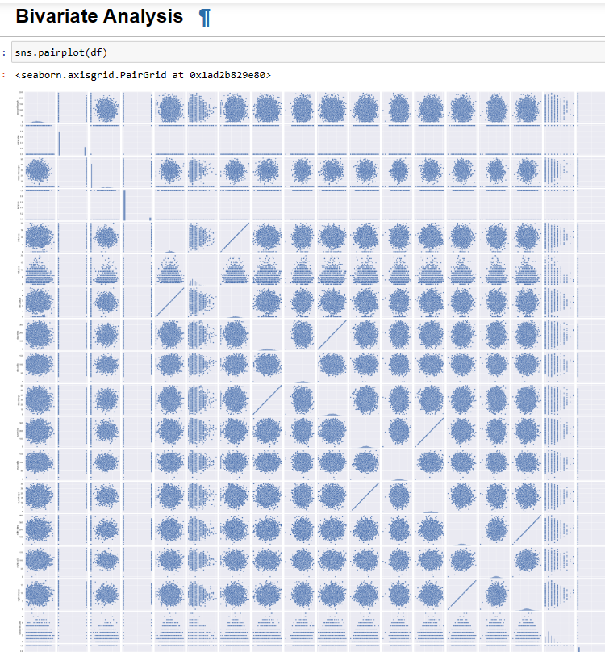
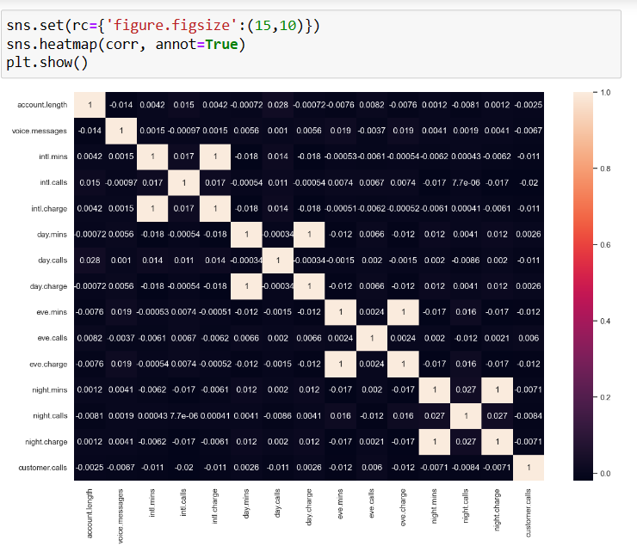
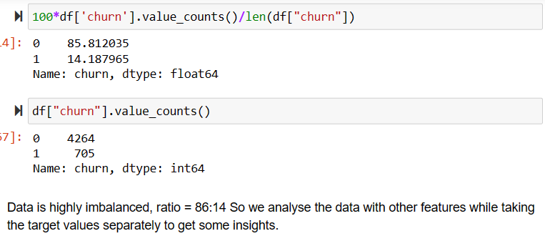
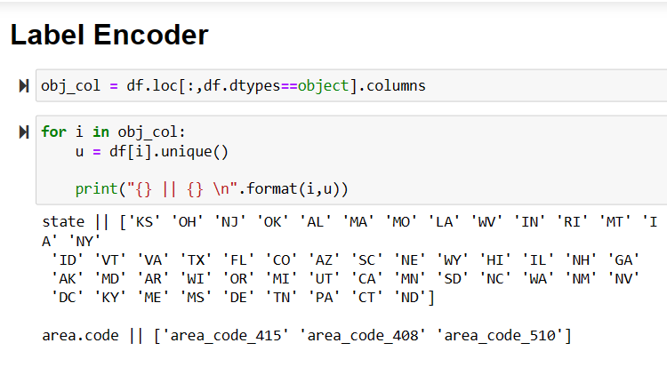

Slide 6
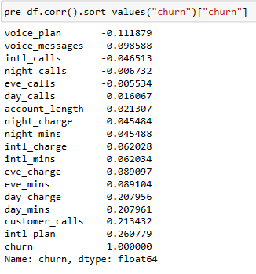
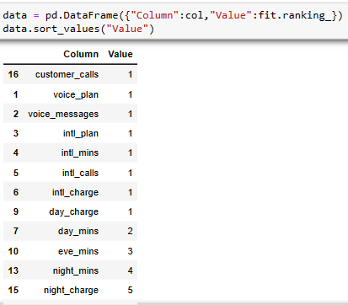
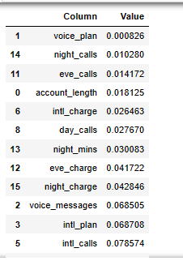
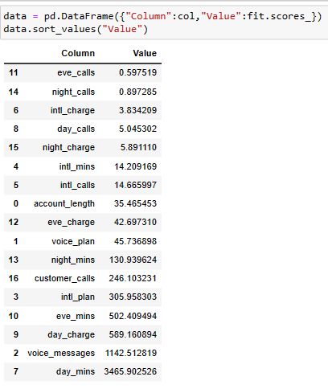
FEATURE SELECTION
Corelation
RFE
Decision Tree Classifier
Univarient Selection

Slide 7
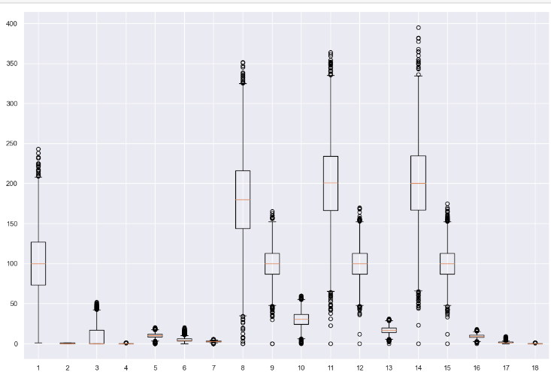

Detecting Outliers
Plotted outliers for all features using boxplot
If outliers were very high in number then used z-scores also to plot outliers
Then took the intersection (common) of both boxplot and z-scores to get outliers
Checked outliers for each columns.
Decided to keep the outliers as it was not confirmed whether they were measurement or data entry errors.
We also replaced churn, voice.plan and intl.plan columns with 1, 0 to convert object into int.

Slide 8
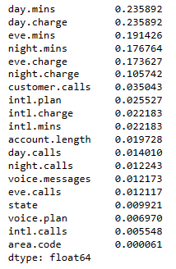
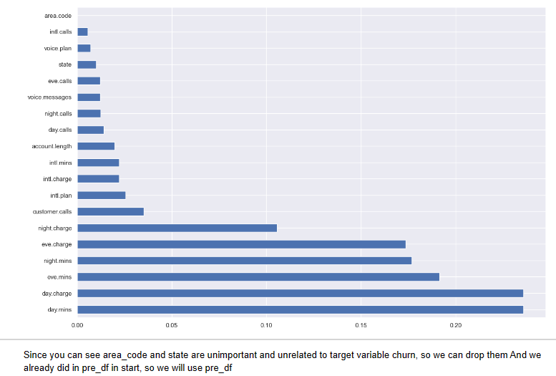
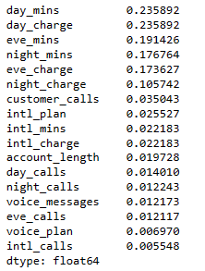
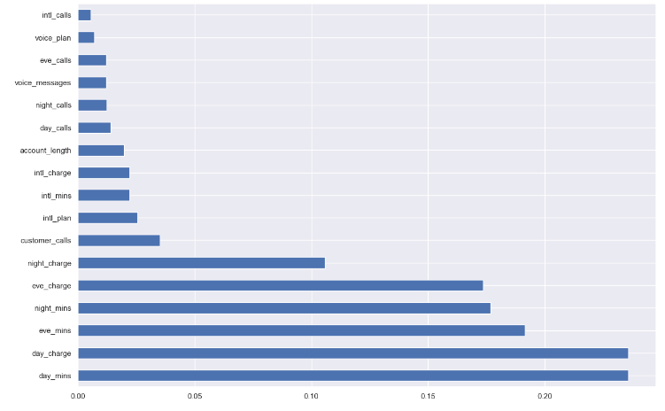
Feature Importance
Mutual Information — Analysis of linear and nonlinear relationships
Mutual information allows us not only to better understand our data but also to identify the predictor variables that are completely independent of the target.
As shown above, area.code, state, Voice.Plan and intl.calls have a mutual information score really close to 0, meaning those variables do not have a strong relationship with the target. This information is in line with the conclusions we have previously drawn by visualizing the data. In the following steps, we should consider removing those variables from the data set before training as they do not provide useful information for predicting the outcome.
The mutual information extends the notion of correlation to nonlinear relationships since, unlike Pearson’s correlation coefficient, this method is able to detect not only linear relationships but also nonlinear ones.

Slide 9
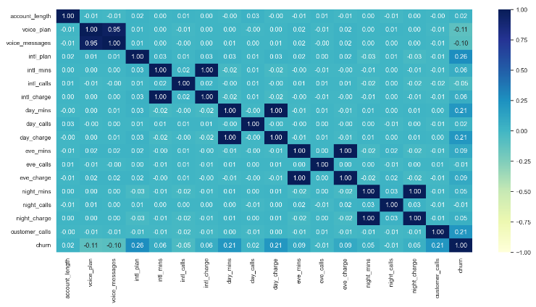
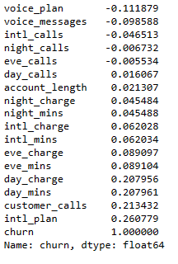
Feature Engineering
Feature Importance - Correlation Matrix / Mutual Information Gain / Anova Test
1. Correlation Matrix
By looking at the above Correlation Matrix, We can observe that International Plan,Customer call are the important features.
one close to zero are unimportant, so day_calls, eve_calls, night_calls, account_length are unimportant

Slide 10
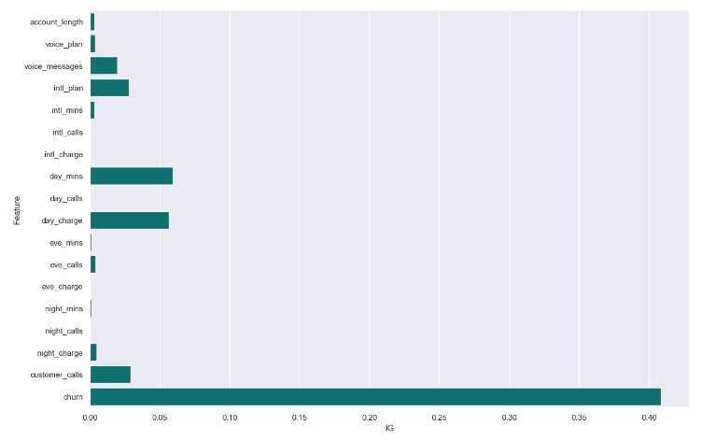
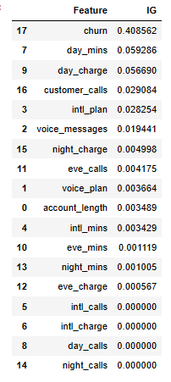
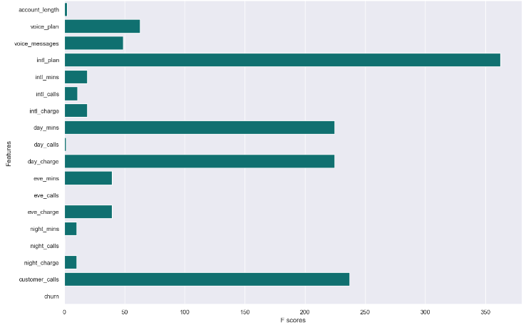
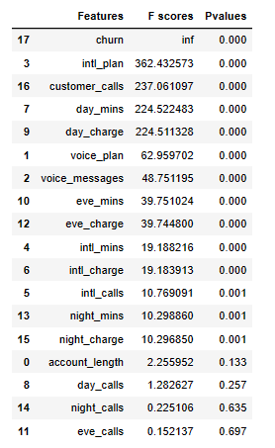
2. Mutual Information Gain
('day_min','day_charge','customer_calls') == important features
eve_calls, day_calls, eve_mins, night_mins, night_calls, account_length are unimportant according to Mutal Inportance gain
3. Anova Test
The result is very significant that after the ANOVA Test. We find out that International Plan,and Customer Calls are the important features.
night_charges, account_length, day_calls, night_calls, eve_calls are unimportant according to anova testing

Slide 11






Multicollinearity - Variance Inflation Factor (VIF)
Splitting the data in training and testing sets

Slide 12




Model Evaluation
Scaled Data - Standard Scaler

Slide 13


SMOTE - Synthetic Minority Oversampling Technique
Smote on Scaled Data
F1 score for all models increased that is why performance better with SMOTE
Hyperparameter tuning
For hyperparameter tuning, we need to split our training data again into a set for training and a set for testing the hyperparameters (often called validation set). It is a very common practice to use k-fold cross-validation for hyperparameter tuning. The training set is divided again into k equal-sized samples, 1 sample is used for testing and the remaining k-1 samples are used for training the model, repeating the process k times. Then, the k evaluation metrics (in this case the accuracy) are averaged to produce a single estimator.
It is important to stress that the validation set is used for hyperparameter selection and not for evaluating the final performance of our model.

Slide 14




Model Optimization - GridSearchCV
Finalizing the Model
Models | Average | Standard Deviation
LR | 0.8595 | 0.0076876
DT | 0.9251 | 0.0030751
SVM | 0.8651 | 0.0128993
NB | 0.8728 | 0.0069586
RF | 0.9591 | 0.0033947
XGB | 0.9589 | 0.0027947
Based on the above results we can see that XGB model and RF model are yielding a high accuracy score
Out of the 2 models XGB model has a slightly lower standard deviation , so we have finalize XGB as final model

